Slide 1

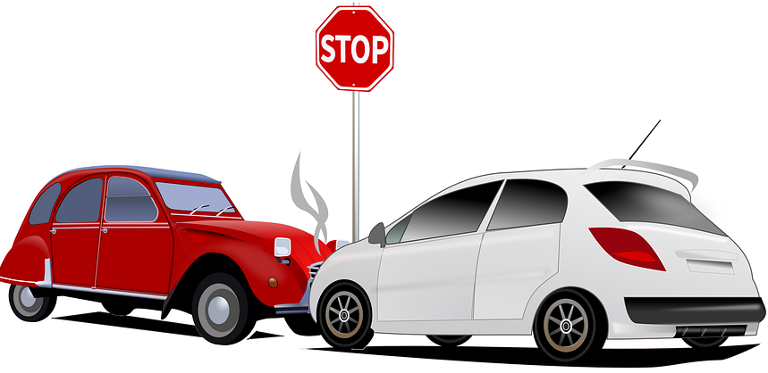

Road Safety in the UK
A Comprehensive Analysis of Car Accident Data
Live data

Slide 2
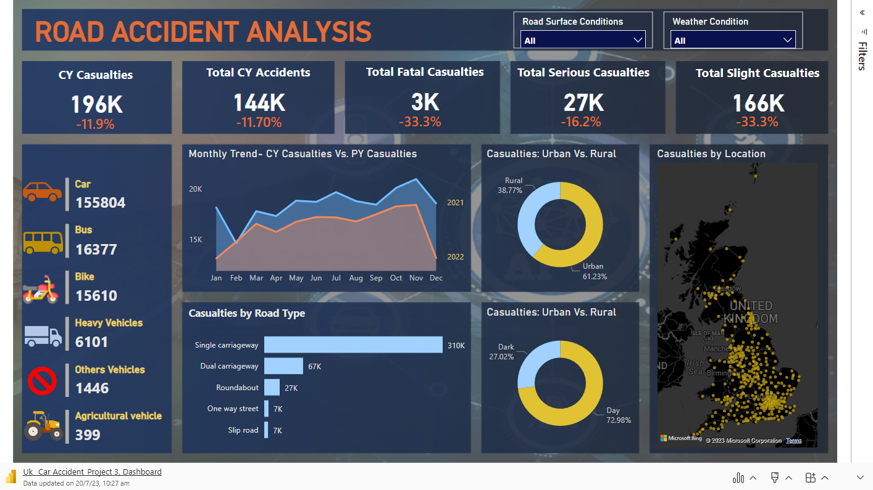

Slide 3
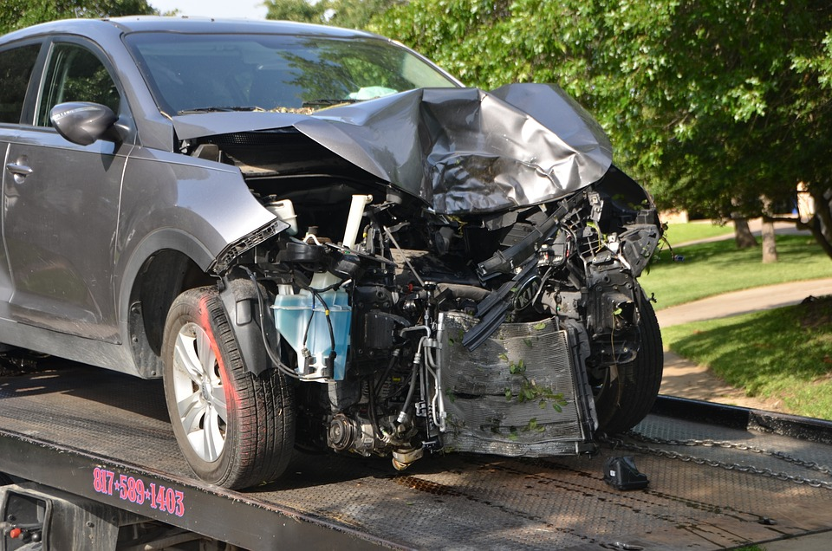
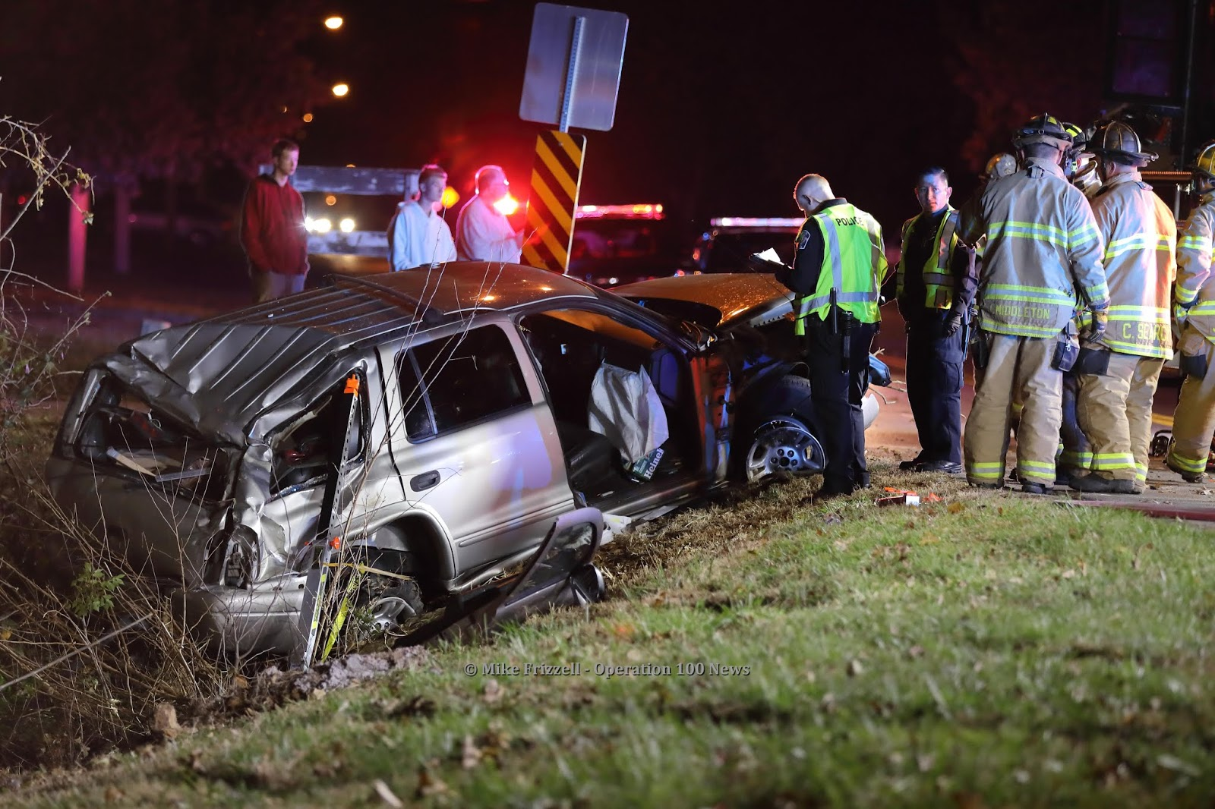
This dashboard titled "Road Accident Analysis" presents a comprehensive overview of car accidents in the UK. The data reveals a total of 196,000 accidents in the current year, reflecting a noteworthy decrease of 11.9% compared to the previous year. Additionally, the total number of casualties in the current year stands at 144,000, marking an 11.7% decrease from the previous year.
The dashboard also highlights specific casualty categories, including 3,000 fatal casualties (a 33.3% decrease), 27,000 serious casualties (a 16.2% decrease), and 166,000 slight casualties (a 10.6% decrease) compared to the previous year.
Analyzing the types of vehicles involved in accidents, cars account for the highest number, with 155,805 incidents, followed by buses (16,377), heavy vehicles (6,101), motorcycles (15,610), and agricultural vehicles (399).
The dashboard further provides insights into casualties concerning light conditions, with 27.03% occurring in dark conditions and 72.98% during daylight.
Moreover, the geographical distribution of accidents indicates that 61.23% of accidents took place in urban areas, while the remaining 38.77% occurred in rural areas.
This Photo by Unknown Author is licensed under CC BY-NC-ND

Slide 4
Lastly, the dashboard highlights monthly trends in casualties, with the highest number recorded in November at 39,414 and the lowest in December at 31,776. The total number of casualties for the year amounts to 417,883.
This road accident analysis provides valuable data for policymakers and authorities to understand the current scenario and take necessary measures to enhance road safety across the UK.

Slide 5
Identified Problem:
The dashboard indicates a significant number of road accidents in the UK, with 196,000 accidents recorded in the current year. Despite a decrease of 11.9% compared to the previous year, the number of accidents remains concerning, highlighting the ongoing road safety challenges in the country. These accidents have resulted in 144,000 casualties, including 3,000 fatal cases, 27,000 serious injuries, and 166,000 slight injuries. The high number of accidents and casualties demands urgent attention from authorities to implement effective road safety measures and reduce the risk of future incidents.

Slide 6
Solution to Improve Road Safety and Reduce Accidents:
Enhance Road Infrastructure: Invest in improving road infrastructure by upgrading existing roads, maintaining signage, and implementing better lighting in critical areas. Well-maintained roads and clear signage can enhance driver awareness and reduce the risk of accidents.
Implement Traffic Management Systems: Install intelligent traffic management systems, such as traffic signals, roundabouts, and speed cameras, to regulate traffic flow and reduce the likelihood of collisions.
Promote Safe Driving Behavior: Launch public awareness campaigns to promote safe driving practices, including the importance of obeying speed limits, avoiding distractions while driving, and wearing seat belts. Education and awareness can play a crucial role in reducing reckless driving behavior.

Slide 7
Strict Enforcement of Traffic Laws: Strengthen law enforcement measures to enforce traffic regulations effectively. Increased patrolling, speed checks, and penalties for traffic violations can deter irresponsible driving behavior.
Improve Driver Training: Enhance driver training programs and license requirements to ensure that new drivers are well-prepared for the road. Continuous education and training for experienced drivers can also reinforce safe driving habits.
Encourage Sustainable Transport: Promote the use of public transportation, cycling, and walking to reduce the number of vehicles on the road. Fewer vehicles can lead to decreased traffic congestion and potentially lower accident rates.
Implement Road Safety Audits: Conduct regular road safety audits to identify potential hazards and address them proactively. Evaluating accident-prone locations and making necessary changes can significantly improve road safety.

Slide 8
Engage Stakeholders: Collaborate with local communities, road safety organizations, and businesses to develop comprehensive road safety initiatives. Engaging stakeholders can foster a collective effort to address road safety concerns.
Invest in Vehicle Safety Features: Encourage the adoption of vehicles equipped with advanced safety features such as automatic emergency braking, lane departure warning systems, and blind-spot monitoring. Safer vehicles can contribute to reducing accident severity.
Data-Driven Approach: Utilize data analytics to identify patterns and trends related to road accidents. Data-driven insights can guide targeted interventions and resource allocation for road safety measures.
Monitor High-Risk Areas: Establish regular monitoring and analysis of high-risk areas to detect emerging trends and address potential safety issues promptly.

Slide 9
Collaborate with Emergency Services: Strengthen collaboration between road authorities and emergency services to ensure swift response and effective assistance in the event of accidents.
By implementing these comprehensive solutions, authorities can significantly enhance road safety in the UK, reduce the number of accidents, and ultimately save lives. A holistic and collaborative approach, supported by data-driven decision-making, is crucial to achieve sustainable improvements in road safety across the country.

Slide 10
Prepared by: Vikas Kashyap, Road Safety Analyst
Objective: Raise awareness about UK road accidents and propose data-driven strategies for accident prevention.
Agenda: Overview of accident data, understanding challenges, data insights, and actionable solutions.
Contact: Email: vikaskashyap9711@gmail.com
LinkedIn ; - https://www.linkedin.com/in/vikaskashyap97/
THANKYOU

